Slide 1
Digital Computer Design
Control Unit

Slide 2
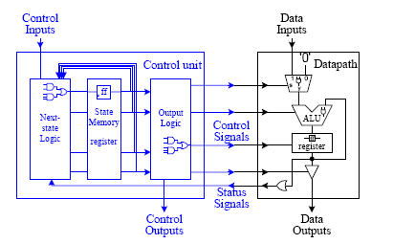
Control Units

Slide 3
Control unit is a sequential circuit in which
its outputs are dependent on both its current and past inputs.
history of past inputs is stored in the state memory
The data path is responsible only for the manipulation of the data; it only performs the register-transfer operations.
It is the control unit that determines when each register-transfer operation is to be executed and in what order.

Slide 4
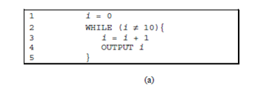
Example counting 1 to 10

Slide 5
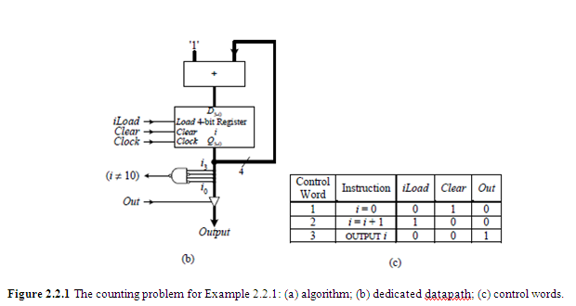

Slide 6
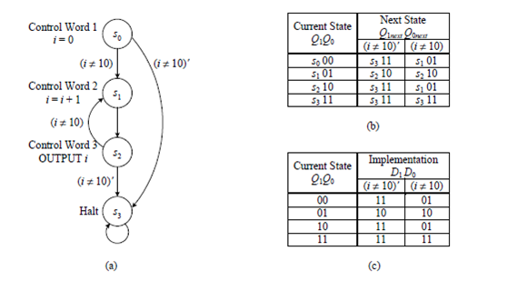

Slide 7
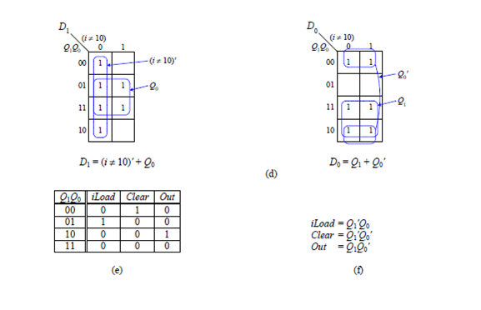

Slide 8
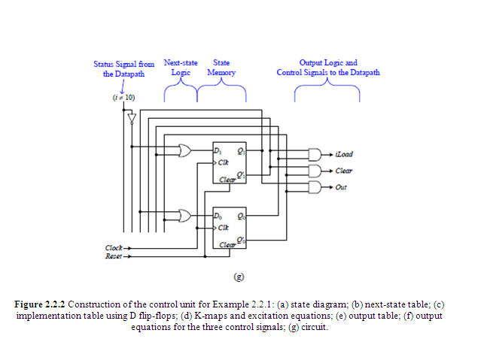

Slide 9
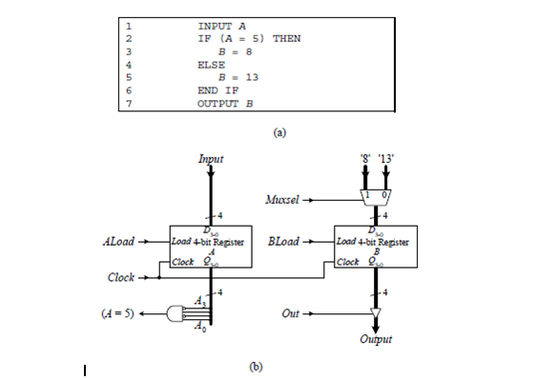
Simple IF –then-Else

Slide 10
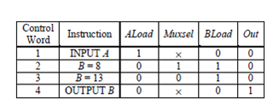

Slide 11
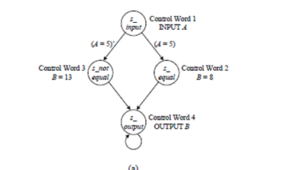
Incorrect state diagram

Slide 12
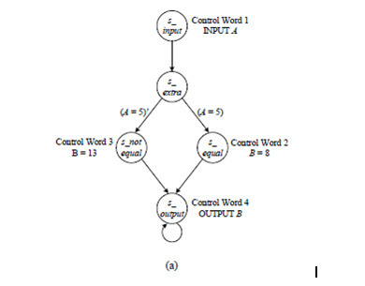
Correct state diagram

Slide 13
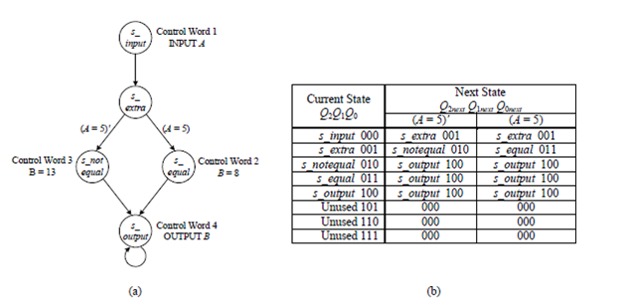

Slide 14
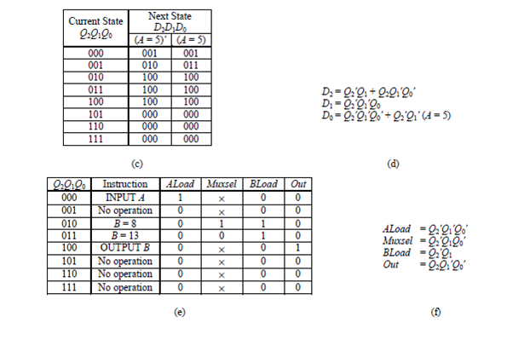

Slide 15
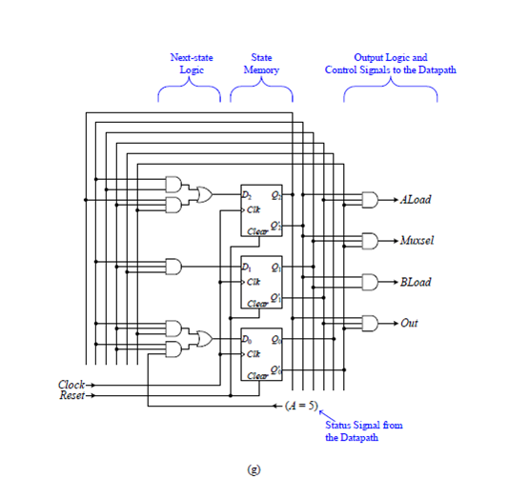

Slide 16
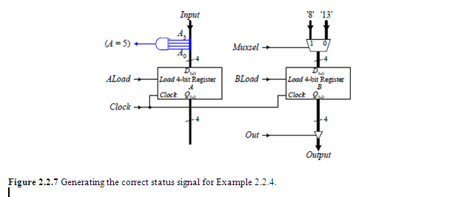
Generating status signals

